Slide 1

Contemporary Business Mathematics with Canadian Applications
Eleventh Canadian Edition
Chapter 3
Ratio, Proportion, and Percent
Copyright © 2018 Pearson Canada Inc.
Notes:
If this PowerPoint presentation contains mathematical equations, you may need to check that your computer has the following installed:
1) MathType Plugin
2) Math Player (free versions available)
3) NVDA Reader (free versions available)

Slide 2
Objectives
Use ratios and proportions to solve allocation and equivalence problems.
Find percents and percent bases to solve business problems.
Find rates and original quantities for increase and decrease problems.
Use proportions and currency cross rate tables to convert currency.
Use index numbers and the Consumer Price Index to compute purchasing power of the Canadian dollar
Use federal income tax brackets and tax rates to calculate federal income taxes.

Slide 3
Ratios (2 of 2)
Can be written in the following ways;
by using the word “to,” such as in “5 to 2”;
by using a colon, such as in “5 : 2”;
as a common fraction, such as “5/2”;
as a decimal, such as “2.50”;
as a percent, such as “250%.”
When comparing more than two numbers or quantities, using the colon is preferred
5 kg : 3 kg : 2 kg we usually drop the units of measure
5 : 3 : 2
The numbers appearing in a ratio are called the terms of the ratio

Slide 4
Reducing Ratios to Lowest Terms
The procedure used to reduce ratios to lowest terms is the same as that used to reduce fractions to lowest terms.
When a ratio is expressed by an improper fraction that reduces to a whole number, the denominator “1” must be written to indicate that two quantities are being compared.
80 : 35 = (16 × 5) : (7 × 5) = 16 : 7 (5 is a common factor)
81 : 54 : 27 = (3 × 27) : (2 × 27) : (1 × 27) = 3 : 2 : 1

Slide 5
Reduce these ratios to the lowest term
a ) 48 : 30 :18 b) 225 : 45 c) 19.25 : 2. 75

Slide 6
Allocation According to a Ratio (1 of 3)
Allocation
John and Eric started the painting business. John invested $4500 and
Eric invested $3000. At the end of the month, the net profit was $6600.
How much Money will each get in this partnership?

Slide 7
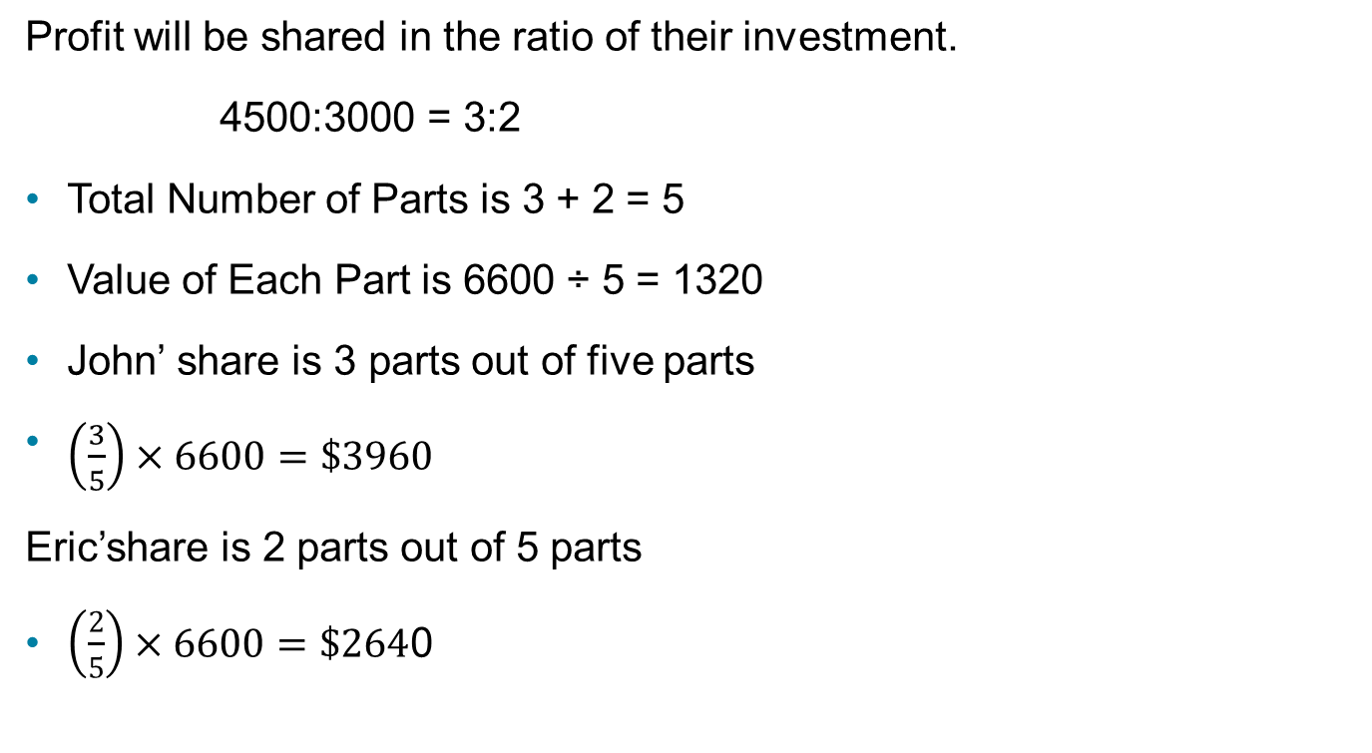
Profit will be shared in the ratio of their investment.
4500:3000 = 3:2
Total Number of Parts is 3 + 2 = 5
Value of Each Part is 6600 ÷ 5 = 1320
John’ share is 3 parts out of five parts
$\left(\frac{3}{5}\right)×6600=\$3960$
Eric’share is 2 parts out of 5 parts
$\left(\frac{2}{5}\right)×6600=\$264$0

Slide 8

Allocation According to a Ratio (2 of 3)
A business suffered a fire loss of $224 640. It was covered by an insurance policy that stated that any claim was to be paid by three insurance companies in the ratio $\frac{1}{3}:\frac{3}{8}:\frac{5}{12}$. What is the amount that each of the three companies will pay?

Slide 9

Allocation According to a Ratio (3 of 3)
$$\frac{1}{3}:\frac{3}{8}:\frac{5}{12}$$
Since the LCD = 24 the equivalent fractions with the same denominator is
$$\frac{8}{24}:\frac{9}{24}:\frac{10}{24}$$
Allocate 8:9:10
Allocation computation | Each company
Total Number of Parts is 8 + 9 + 10 = 27 | Company #1 $66,560
Value of Each Part is 224,640 ÷ 27 = $8320 | Company #2 $74,880
8 × 8320 = $66,560 9× 132 = $74,880 10 × 8320 = $83,200 Total = $224,640 | Company #3 $83,200

Slide 10
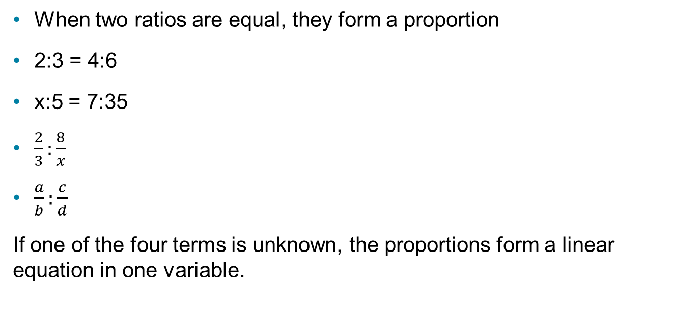
Proportions (1 of 3)
When two ratios are equal, they form a proportion
2:3 = 4:6
x:5 = 7:35
$\frac{2}{3}:\frac{8}{x}$
$\frac{a}{b}:\frac{c}{d}$
If one of the four terms is unknown, the proportions form a linear equation in one variable.
are proportions

Slide 11
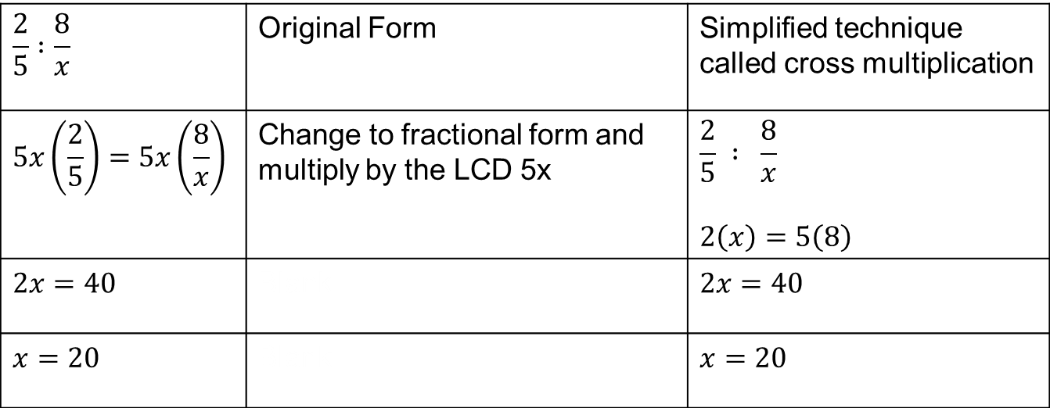
Proportions (2 of 3)
Solve the proportion 2 : 5 = 8 : x
$$\frac{2}{5} :\frac{8}{x}$$ | Original Form | Simplified technique called cross multiplication
$$5x\left(\frac{2}{5}\right)=5x\left(\frac{8}{x}\right)$$ | Change to fractional form and multiply by the LCD 5x | $$\frac{2}{5} : \frac{8}{x}$$ $$2\left(x\right)=5\left(8\right)$$
$$2x=40$$ | Blank | $$2x=40$$
$$x=20$$ | Blank | $$x=20$$

Slide 12
Set up proportion :
a) The community of Oakcrest sets a property tax rate of $28 per $1000 assessed valuation. What is the assessment if the tax is $854.
b) A manufacturing process requires $85 supervision cost for every 64 labor hours. At the same rate how much supervision cost must be budgeted for 16 000 labor hours.

Slide 13
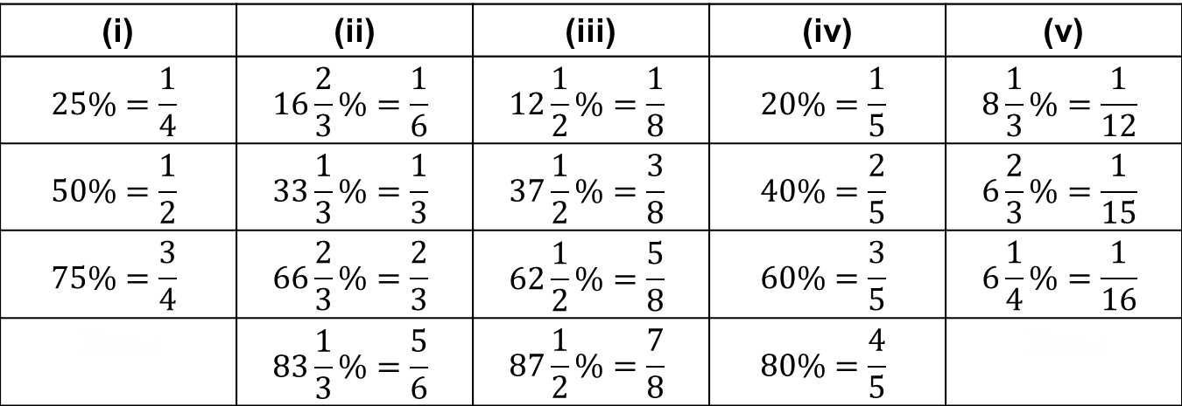
Computation with Commonly Used Percents
Table 3.1 Commonly Used Percents and Their Fractional Equivalents
(i) | (ii) | (iii) | (iv) | (v)
$$25\%=\frac{1}{4}$$ | $$16\frac{2}{3}\%=\frac{1}{6}$$ | $$12\frac{1}{2}\%=\frac{1}{8}$$ | $$20\%=\frac{1}{5}$$ | $$8\frac{1}{3}\%=\frac{1}{12}$$
$$50\%=\frac{1}{2}$$ | $$33\frac{1}{3}\%=\frac{1}{3}$$ | $$37\frac{1}{2}\%=\frac{3}{8}$$ | $$40\%=\frac{2}{5}$$ | $$6\frac{2}{3}\%=\frac{1}{15}$$
$$75\%=\frac{3}{4}$$ | $$66\frac{2}{3}\%=\frac{2}{3}$$ | $$62\frac{1}{2}\%=\frac{5}{8}$$ | $$60\%=\frac{3}{5}$$ | $$6\frac{1}{4}\%=\frac{1}{16}$$
Blank | $$83\frac{1}{3}\%=\frac{5}{6}$$ | $$87\frac{1}{2}\%=\frac{7}{8}$$ | $$80\%=\frac{4}{5}$$ | Blank

Slide 14

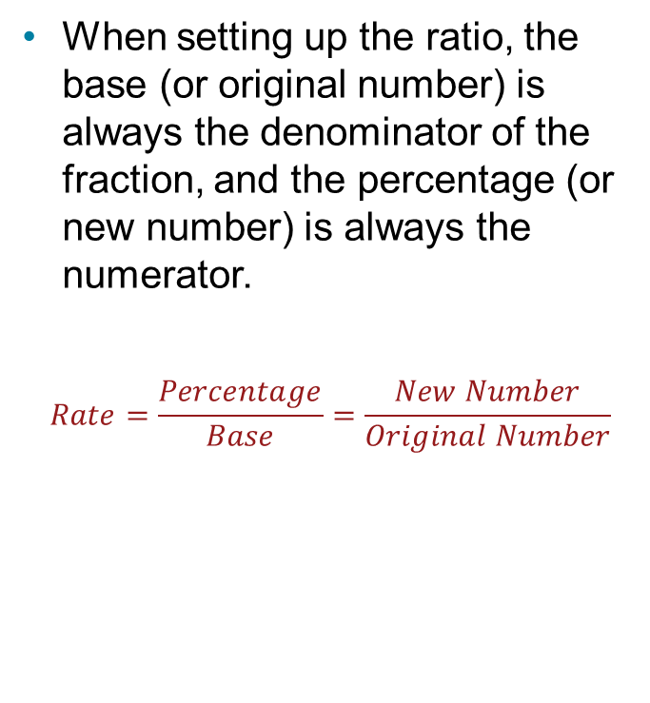
Finding a Rate Percent
When setting up the ratio, the base (or original number) is always the denominator of the fraction, and the percentage (or new number) is always the numerator.
$$Rate=\frac{Percentage}{Base}=\frac{New Number}{Original Number}$$
What percent of $150 is 65?
$$Rate=\frac{65}{150}=0.4\dot{3}=43.\dot{3}\%$$

Slide 15
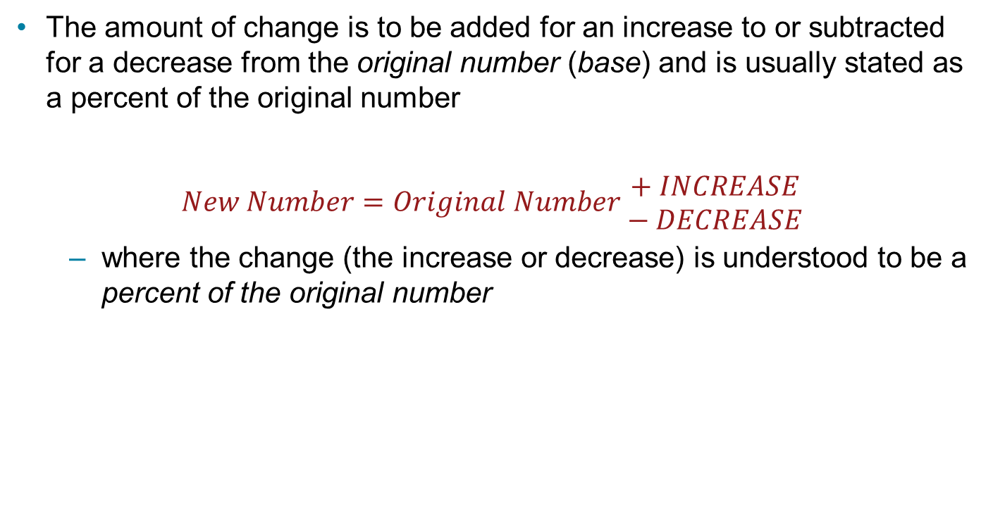
Problems Involving Increase or Decrease (1 of 3)
The amount of change is to be added for an increase to or subtracted for a decrease from the original number (base) and is usually stated as a percent of the original number
$$New Number=Original Number \begin{matrix}+ INCREASE \\ − DECREASE\end{matrix}$$
where the change (the increase or decrease) is understood to be a percent of the original number

Slide 16
Problems Involving Increase or Decrease (2 of 3)
36 increased by 25% is what number?
The original number is 36.
The change (increase) is 25% of 36.
The original number is known.
Let x represent the new number.
36 + 25% of 36 = x
36 + 0.25 × 36 = x
36 + 9 = x
x = 45

Slide 17
Problems Involving Increase or Decrease (3 of 3)
What number is 40% less than 75?
The change (decrease) is 40% of 75.
The original number is 75.
Let x represent the new number
75 − 40% of 75 = x
75 − 0.40 × 75 = x
75 − 30 = x
x = 45

Slide 18

Finding Rate of Increase or Decrease (1 of 2)
Amount of change in percent.
$$Rate of Change= \frac{Amount of Change}{Original Number}$$
$325 is what percent more than $200?

Slide 19
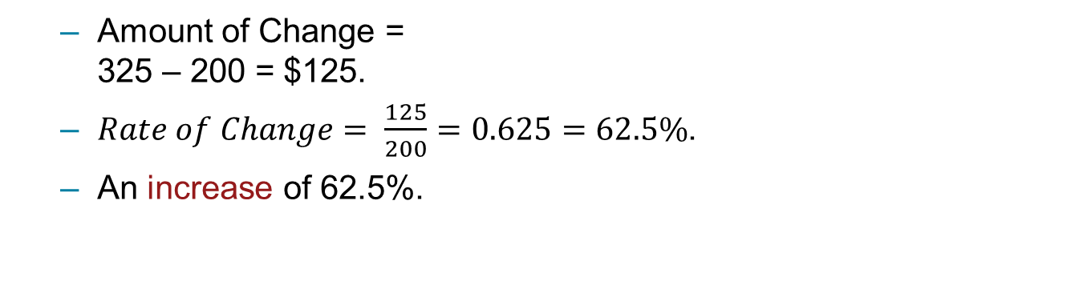
Find the increase or decrease
Amount of Change = 325 – 200 = $125.
$Rate of Change= \frac{125}{200}=0.625=62.5\%$.
An increase of 62.5%.

Slide 20
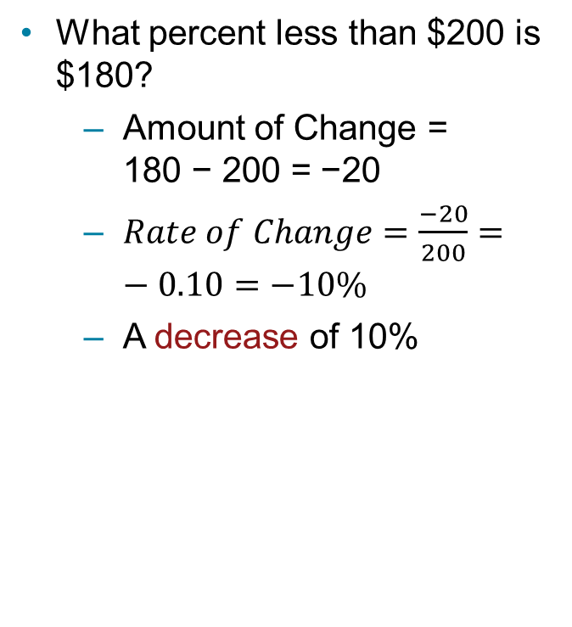

Finding Rate of Increase or Decrease (2 of 2)
Amount of change in percent
$$Rate of Change= \frac{Amount of Change}{Original Number}$$
What percent less than $200 is $180?
Amount of Change = 180 − 200 = −20
$Rate of Change=\frac{−20}{200}=−0.10=−10\%$
A decrease of 10%

Slide 21
Finding the Original Amount
Ravi wants to pay off his student loan within the next three years, so he has increased his original weekly payment by 60%. His new payment is now $88 per week. How much was his original payment?

Slide 22
Let the original amount be x
x + 60% of x = 88
x + 0.60(x) = 88
1.60x = 88
x = $55 (the original payment)

Slide 23
Try Yourself
Expenditure for a government program were reduced from $75000 to $60000. What percent change does this represent. Further, Government made a promise that there will be an increase of 5% in funding each year for next four years. What will be the amount after four years.

Slide 24
Currency Conversion
The exchange rate equals the value of one nation’s currency expressed in terms of another nation’s currency
The exchange rate tells us how much of one currency we need to buy one unit of another currency
( usually larger amount of money is involved in currency exchanges, therefore, two decimal rule of money is insufficient.
To produce accurate results, currency exchange rate need to carry at least four decimals.

Slide 25
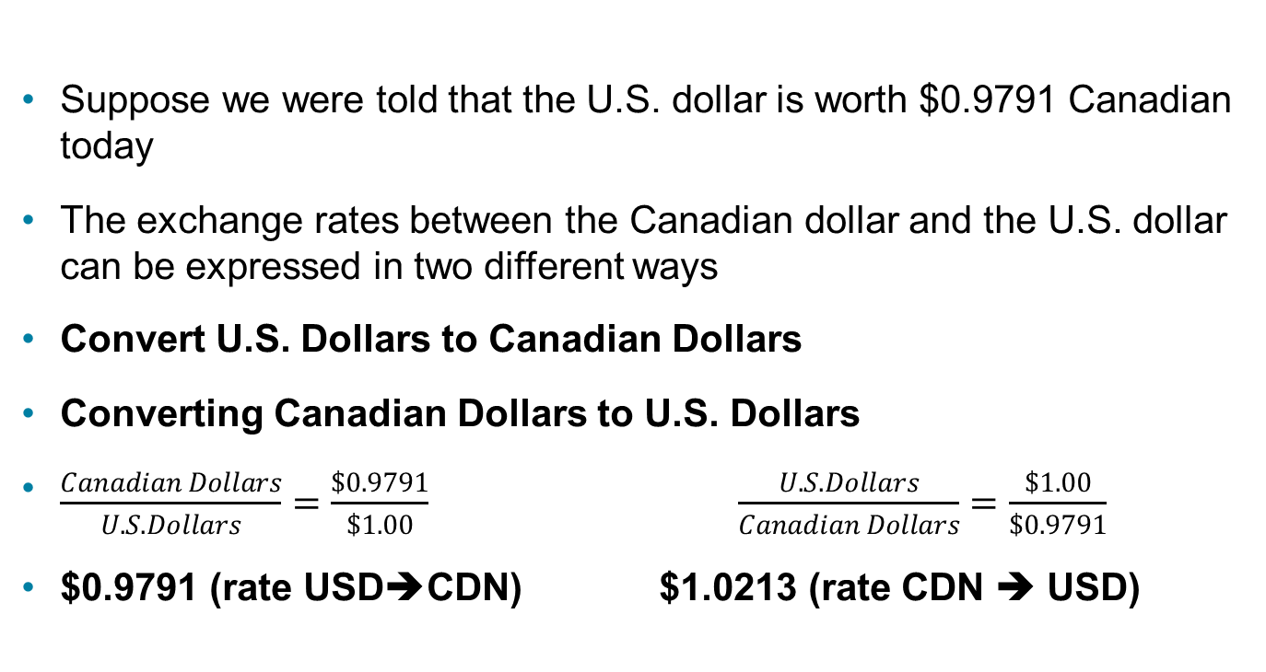
Currency Conversion
Suppose we were told that the U.S. dollar is worth $0.9791 Canadian today
The exchange rates between the Canadian dollar and the U.S. dollar can be expressed in two different ways
Convert U.S. Dollars to Canadian Dollars
Converting Canadian Dollars to U.S. Dollars
$\frac{Canadian Dollars}{U.S. Dollars}=\frac{\$0.9791}{\$1.00} \frac{U.S. Dollars}{Canadian Dollars}=\frac{\$1.00}{\$0.9791}$
$0.9791 (rate USD➔CDN) $1.0213 (rate CDN ➔ USD)

Slide 26
Currency Conversion
The best way to choose the exchange rate is to express the exchange rate as a proportion of two currencies so that the wanted currency is in the numerator of the known ratio

Slide 27
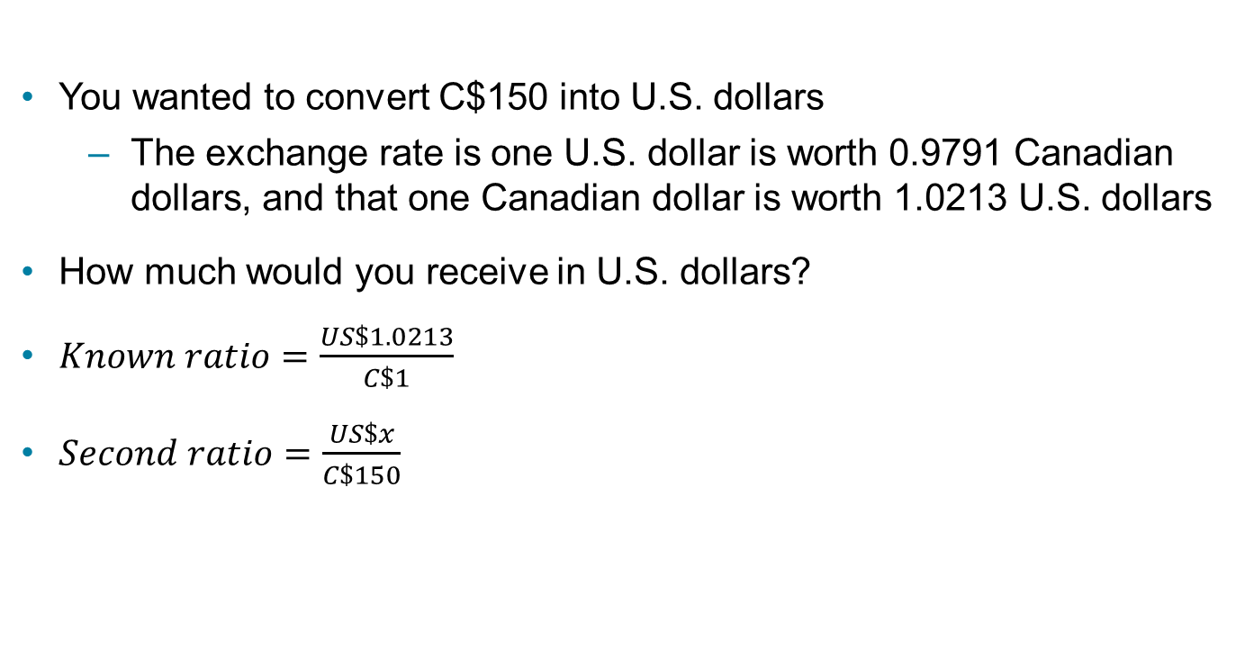
Currency Conversion
You wanted to convert C$150 into U.S. dollars
The exchange rate is one U.S. dollar is worth 0.9791 Canadian dollars, and that one Canadian dollar is worth 1.0213 U.S. dollars
How much would you receive in U.S. dollars?
$Known ratio=\frac{US\$1.0213}{C\$1}$
$Second ratio=\frac{US\$x}{C\$150}$

Slide 28

Currency Conversion
$Proportion=\frac{US\$1.0213}{C\$1}=\frac{US\$x}{C\$150}$
Cross-multiply and solve
$$x=1.0213\left(150\right)=\$153.195$$
C$150 is worth US$153.20

Slide 29
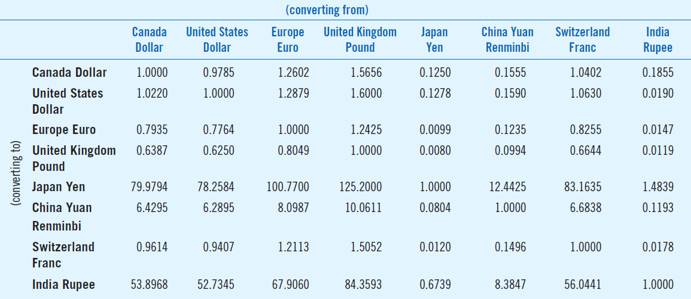
Currency Conversion using cross tables
Sample Cross Rate Table

Slide 30
Currency Conversion using cross table
Suppose you are taking a trip from Canada to France, and then to Japan
Convert C$100 to euros, then convert the euros to Japanese yen. Use the exchange rates in using the sample cross rate table in the previous slide

Slide 31
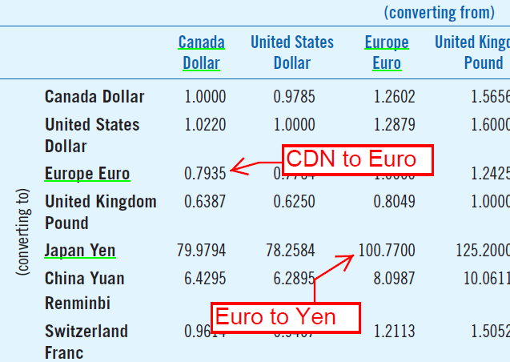
Cross tables
From the table, the exchange rate for
Canadian dollars to euros is 0.7935
Conversion = 100 × 0.7935 = 79.35 euros
From the table, the exchange
rate for euros to Japanese yen is
100.77Conversion = 79.35 × 100.77
= 7996 Japanese Yen

Slide 32
Currency Conversion Try Yourself
Suppose it costs C$260 to purchase $245.23.
A) What is the exchange rate?
B) How many U.S dollars will you receive if you convert C$725 into
U.S dollars?

Slide 33
Applications of Percent
Index Numbers, CPI and Personal Taxes

Slide 34
Index Numbers (1 of 2)
Results when you compare two values of the same thing measured at different points in time.
The comparison of the two values is stated as a ratio, and then expressed as a percent.
When the percent symbol is dropped, the result is called an index number.
Indexes provide an easy way of expressing changes that occur in daily business.

Slide 35
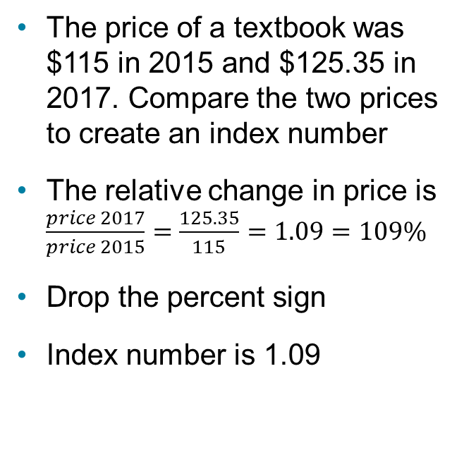
Index Numbers (2 of 2)
Construction
Example
Select one of the two values as the denominator of the ratio.
The point in time at which the denominator was measured is called the base period.
The index for the base period is always 100.
The difference between an index number and 100 indicates the relative change that has taken place.
The price of a textbook was $115 in 2015 and $125.35 in 2017. Compare the two prices to create an index number
The relative change in price is $\frac{price 2017}{price 2015}=\frac{125.35}{115}=1.09=109\%$
Drop the percent sign
Index number is 1.09

Slide 36
Consumer Price Index (CPI) (1 of 7)
The most widely accepted indicator of changes in the overall price level of goods and services.
In Canada, a fixed “basket” or collection of goods and services is used to represent all Canadian goods and services.
The prices of the items in this collection are monitored and are used to represent the price change of all goods and services.
The CPI is currently based on 2002 price levels and is published monthly by Statistics Canada.
CPI by province link to statcan

Slide 37

Consumer Price Index (CPI) (2 of 7)
Purchasing power of the dollar is the reciprocal of the CPI.
$$\begin{matrix}Purchasing Power \\ of the Dollar\end{matrix}=\frac{\$1}{Consumer Price Index}\left(100\right)$$

Slide 38
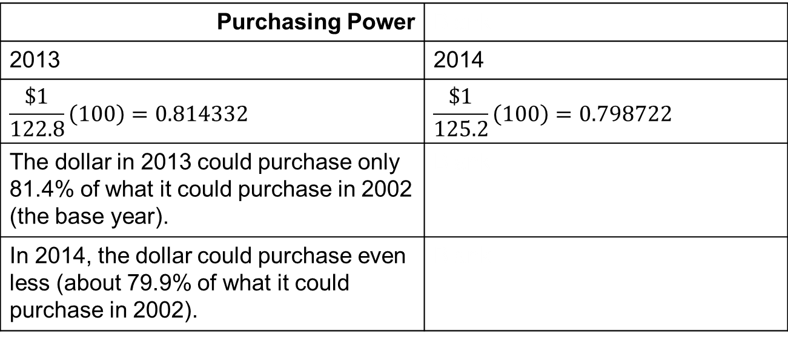
Purchasing Power of the Dollar
The CPI was 122.8 for 2013 and 125.2 for 2014. Determine the purchasing power of the Canadian dollar for the two years, and interpret the meaning of the results.
Purchasing Power | Blank
2013 | 2014
$$\frac{\$1}{122.8}\left(100\right)=0.814332$$ | $$\frac{\$1}{125.2}\left(100\right)=0.798722$$
The dollar in 2013 could purchase only 81.4% of what it could purchase in 2002 (the base year). | Blank
In 2014, the dollar could purchase even less (about 79.9% of what it could purchase in 2002). | Blank

Slide 39

Consumer Price Index (CPI) (3 of 7)
Can be used to eliminate the effect of inflation on income by adjusting nominal income (income stated in current dollars) to real income (income stated in base-period dollars or inflation-adjusted income).
$$Real Income=\frac{Income in current dollars}{Consumer price index}\left(100\right)$$

Slide 40
Consumer Price Index (CPI) (4 of 7)
James’ income was $50,000 in 2007, $53,000 in 2011, and $56,000 in 2014. The Canadian CPI was 111.5 in 2011 and 125.2 in 2014. The CPI base year is 2002.
Determine James’ real income in 2011 and 2014.
Should James be happy about his increases in salary from 2007 to 2014?

Slide 41
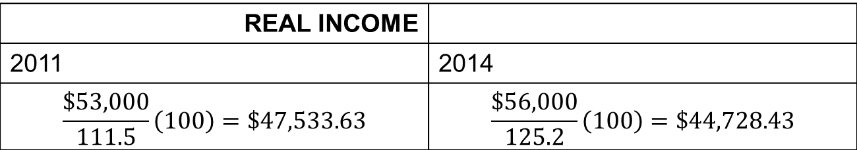
Consumer Price Index (CPI) (5 of 7)
REAL INCOME | Blank
2011 | 2014
$$\frac{\$53,000}{111.5}\left(100\right)=\$47,533.63$$ | $$\frac{\$56,000}{125.2}\left(100\right)=\$44,728.43$$
Nominal income
CPI
Nominal income
CPI

Slide 42
Consumer Price Index (CPI) (6 of 7)
Should James be happy?
To compare nominal income with real income, it is useful to determine income changes in absolute and relative terms.

Slide 43
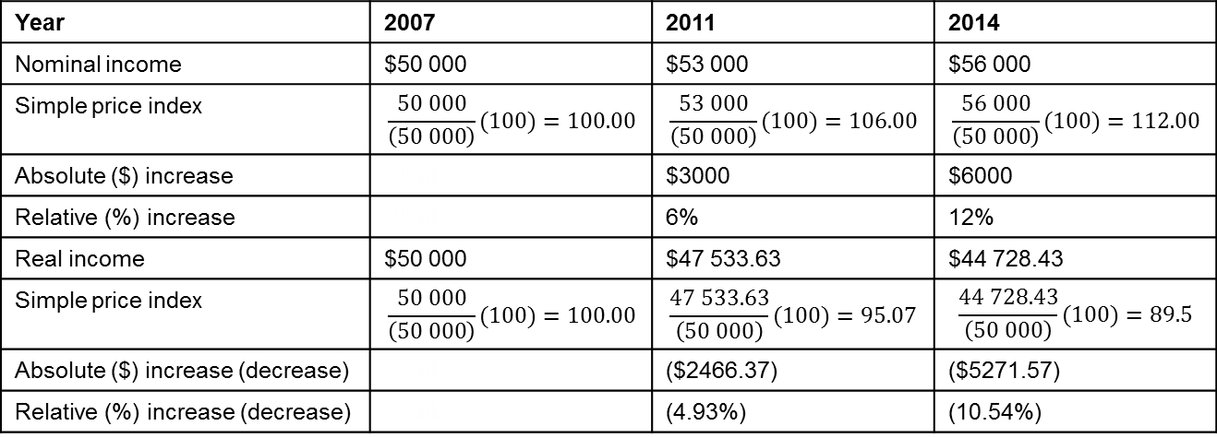
Consumer Price Index (CPI) (7 of 7)
James’ income in 2011 increased 6% over his 2007 income, his purchasing power (2011 real income) actually decreased by 4.93% over the four-year period.
From 2007 to 2014, his nominal income increased by 12.0% over his 2007 income.
His real income decreased by 10.54% during the period 2007 to 2014.
Year | 2007 | 2011 | 2014
Nominal income | $50 000 | $53 000 | $56 000
Simple price index | $$\frac{50 000}{\left(50 000\right)}(100)=100.00$$ | $$\frac{53 000}{\left(50 000\right)}(100)=106.00$$ | $$\frac{56 000}{\left(50 000\right)}(100)=112.00$$
Absolute ($) increase | Blank | $3000 | $6000
Relative (%) increase | Blank | 6% | 12%
Real income | $50 000 | $47 533.63 | $44 728.43
Simple price index | $$\frac{50 000}{\left(50 000\right)}(100)=100.00$$ | $$\frac{47 533.63}{\left(50 000\right)}(100)=95.07$$ | $$\frac{44 728.43}{\left(50 000\right)}(100)=89.5$$
Absolute ($) increase (decrease) | Blank | ($2466.37) | ($5271.57)
Relative (%) increase (decrease) | Blank | (4.93%) | (10.54%)

Slide 44
Personal Income Taxes (1 of 5)
Personal income taxes are taxes imposed by the federal and provincial governments on the earned income of residents of Canada.
The federal government collects and refunds income taxes based on the income you calculate on your income tax return each year.

Slide 45
Personal Income Taxes (2 of 5)
Provincial tax brackets vary by province, and federal tax rates currently range from 15% to 29% of taxable income.
The tax rates increase as your income increases.
Table 3.3 2015 Federal Income Tax Brackets and Tax Rates
Taxable Income (income tax brackets) | Tax Rates
$44 701 or less | 15% of taxable income less than or equal to $44 701; plus
Over $44 701 up to $89 401 | 22% of taxable income greater than $44 701 and less than or equal to $89 401; plus
Over $89 401 up to $138 586 | 26% of taxable income greater than $89 401 and less than or equal to $138 586; plus
Over $138 586 | 29% of taxable income greater than $138 586

Slide 46
Personal Income Taxes (3 of 5)
Income tax brackets are adjusted annually for changes in the Consumer Price Index (CPI) in excess of 3%. If the CPI increases by less than 3% during a year, there is no increase in the tax brackets.
The marginal tax rate is the rate at which your next dollar of earned income is taxed. Your marginal tax rate increases when your earnings increase and you move from a lower tax bracket to a higher tax bracket (and vice versa).

Slide 47
Personal Income Taxes (4 of 5)
Use the tax brackets and rates in Table 3.3 to compute the federal tax for Jim, Kulvir, and Lee, who are, respectively, declaring taxable income of
$30 000
$60 000
$90 00
Table 3.3 2015 Federal Income Tax Brackets and Tax Rates
Taxable Income (income tax brackets) | Tax Rates
$44 701 or less | 15% of taxable income less than or equal to $44 701; plus
Over $44 701 up to $89 401 | 22% of taxable income greater than $44 701 and less than or equal to $89 401; plus
Over $89 401 up to $138 586 | 26% of taxable income greater than $89 401 and less than or equal to $138 586; plus
Over $138 586 | 29% of taxable income greater than $138 586

Slide 48
Personal Income Taxes (5 of 5)
Federal Taxes | Blank
Jim | 15% × $30,000 = $4,500
Kulvir | 15% × $44,701 + 22% × (60,000 – 44,701) = $6,705.15 + $3,365.78 = $10070.93
Lee | 15% × $44,701 + 22% × (89,401 – 44,701) + 22% × (90,000 – 89,401) = 6,705.15 + 9,834 + 155.74 = $16,694.89

